Slide 1

RADAR TECHNOLOGY AND ELECTROMAGNETIC WAVE

Slide 2
RADAR TECHNOLOGY AND ELECTROMAGNETIC WAVE

Slide 3
What is Radar?
The acronym Radar stands for RAdio Detection And Ranging.
It describes systems that are actively sending electromagnetic microwaves from a satellite or an aircraft.
A radar antenna is receiving the echoes that are backscattered from the Earth or ocean surface.

Slide 4
What are microwaves?
Microwaves are electromagnetic radiation.
Their wavelength can vary between a few millimeters up to one meter.
In the electromagnetic spectrum they can be found between the longer radio waves and the shorter infrared waves.

Slide 5
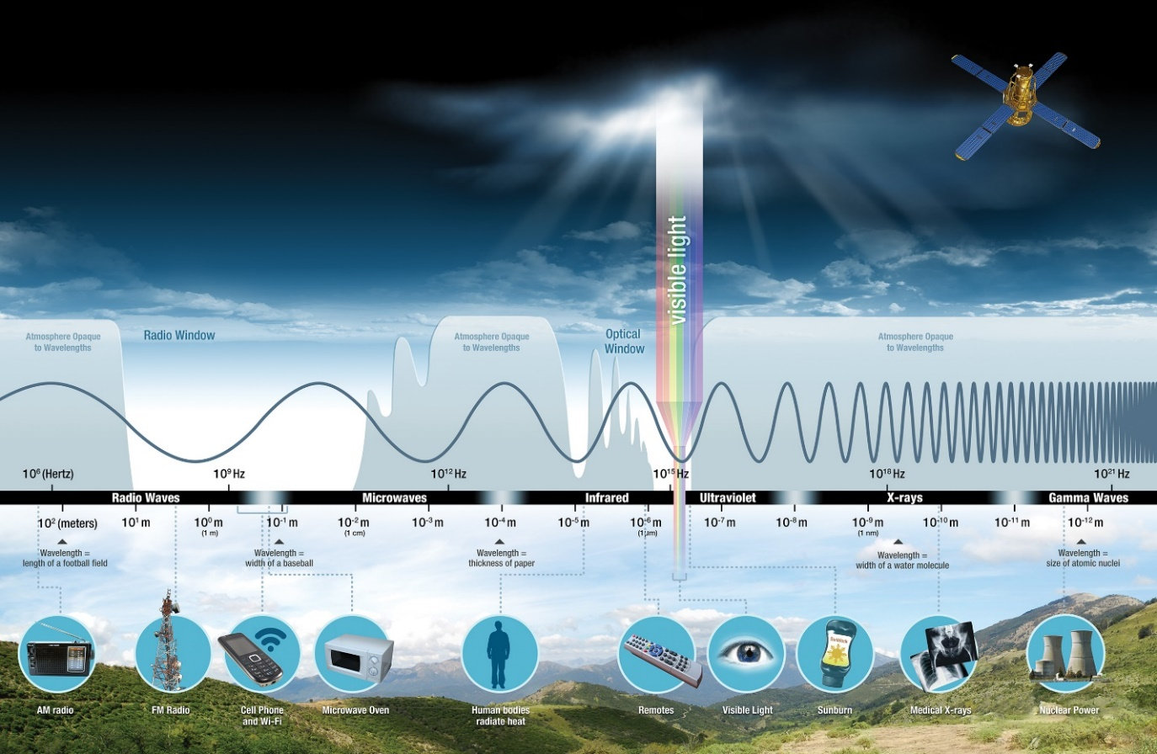
Electromagnetic spectrum.

Slide 6
Why we need Radar satellites?
Radar technology offers unique features that help to overcome the shortcomings of optical remote sensing systems and complement the information collected by such systems.
The independence of radar to solar illumination and weather are major advantages. Radar acquisitions of the surface of the Earth are possible both day and night, regardless of cloud cover.

Slide 7
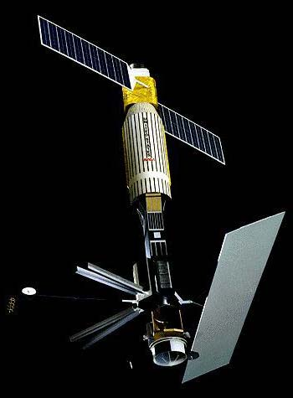
A brief history of radar remote sensing
First satellite radar (1978)
Seasat was the first (civilian) spaceborne imaging radar.
Seasat flew a microwave altimeter and a multi-beam scatterometer (the Seasat-A Satellite Scatterometer, or SASS) primarily aimed at studying the oceans, as well as the first civilian spaceborne imaging synthetic aperture radar.
Despite lasting only a few months, the Seasat instrument clearly defined a niche role for active microwave instruments in studying the ocean at a range of scales.

Slide 8
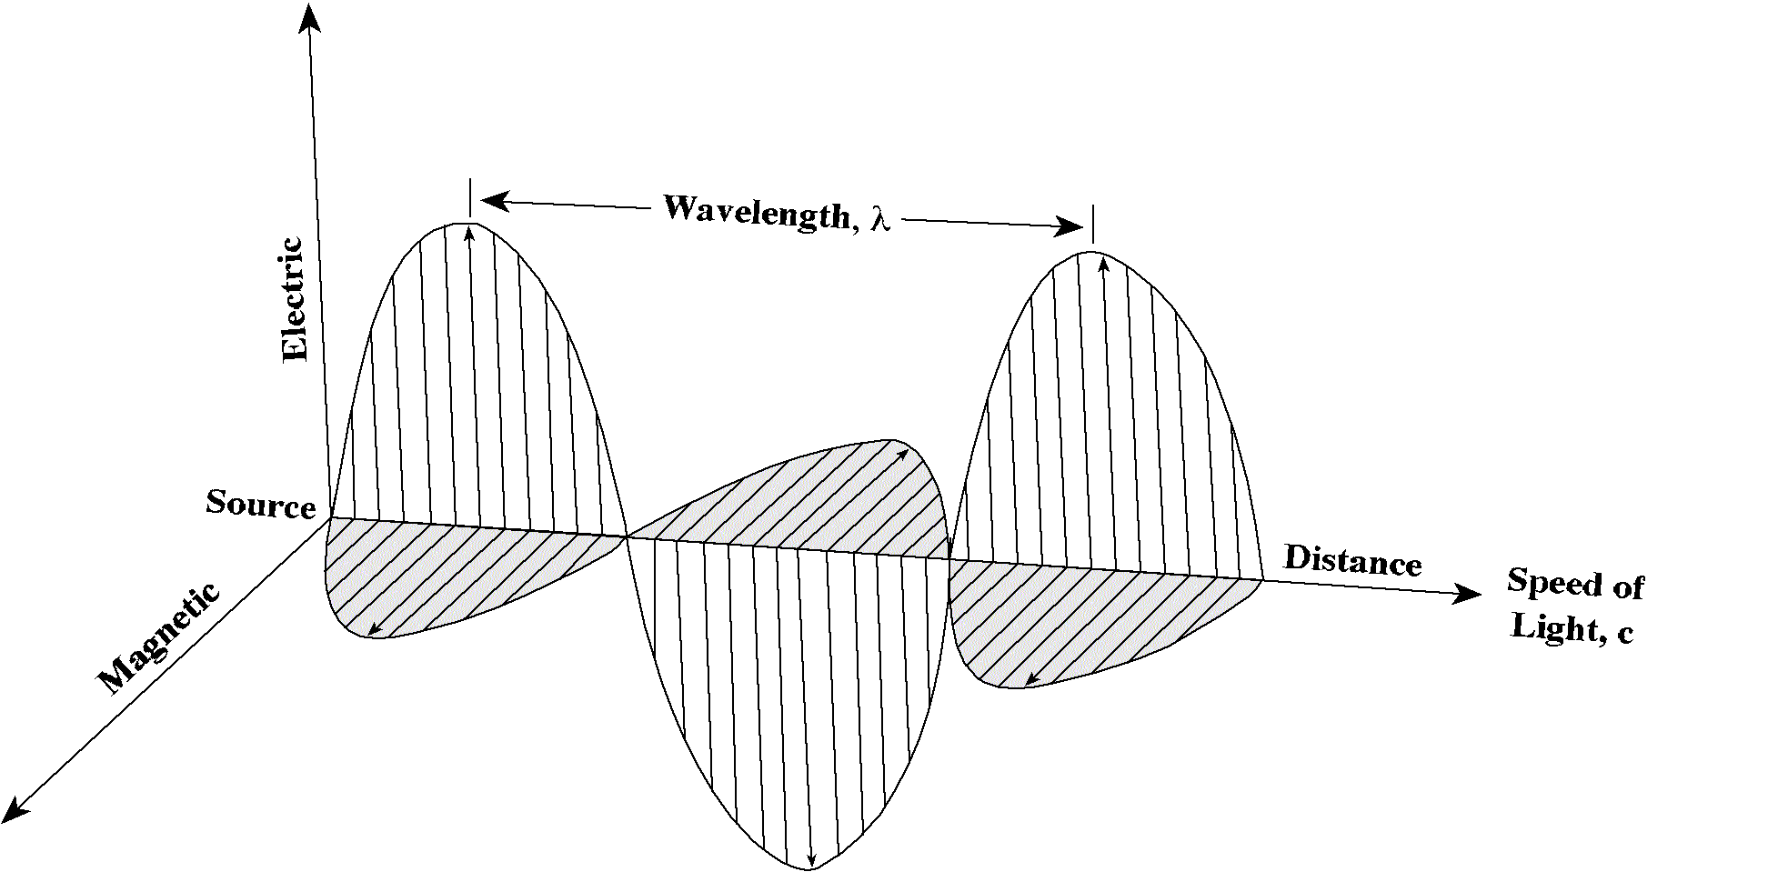
What is an electromagnetic wave?
In remote sensing, this radiation is often described with the help of the wave model, as opposed to the similarly popular corpuscular model, in which the properties of light are described with the concept of photons.
Wave Model EMR
EM propagate through space in the form of waves characterized by two fields: i.e. electric and magnetic field.
They are perpendicular to each other and propagate through space at light speed. EM is characterized by wave length and frequency.
Jensen, 2000

Slide 9
Energy, a measure of the ability to do work, comes in many forms and can transform from one type to another.
Examples of stored or potential energy include batteries and water behind a dam.
Objects in motion are examples of kinetic energy.
Charged particles—such as electrons and protons—create electromagnetic fields when they move, and these fields transport the type of energy we call electromagnetic radiation, or light.

Slide 10
What are waves?
Mechanical waves and electromagnetic waves are two important ways that energy is transported in the world around us.
Examples of mechanical waves: waves in water and sound waves in air
Mechanical waves are caused by a disturbance or vibration in matter, whether solid, gas, liquid, or plasma.
Matter that waves are traveling through is called a medium.
Water waves are formed by vibrations in a liquid and sound waves are formed by vibrations in a gas (air).
These mechanical waves travel through a medium by causing the molecules to bump into each other.
Sound waves cannot travel in the vacuum of space because there is no medium to transmit these mechanical waves.

Slide 11
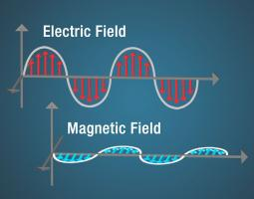
Electromagnetic Waves
Electricity can be static, like the energy that can make your hair stand on end. Magnetism can also be static, as it is in a refrigerator magnet.
A changing magnetic field will induce a changing electric field and vice-versa—the two are linked.
These changing fields form electromagnetic waves. Electromagnetic waves differ from mechanical waves in that they do not require a medium to propagate.
This means that electromagnetic waves can travel not only through air and solid materials, but also through the vacuum of space.

Slide 12
Describing electromagnetic Energy
The terms light, electromagnetic waves, and radiation all refer to the same physical phenomenon: electromagnetic energy.
This energy can be described by frequency, wavelength, or energy.
All three are related mathematically such that if you know one, you can calculate the other two.
Radio and microwaves are usually described in terms of frequency (Hertz), infrared and visible light in terms of wavelength (meters), and x-rays and gamma rays in terms of energy (electron volts).
This is a scientific convention that allows the convenient use of units that have numbers that are neither too large nor too small.

Slide 13
Frequency
The number of crests that pass a given point within one second is described as the frequency of the wave.
One wave—or cycle—per second is called a Hertz (Hz), after Heinrich Hertz who established the existence of radio waves.
A wave with two cycles that pass a point in one second has a frequency of 2 Hz.
Wavelength
Electromagnetic waves have crests and troughs similar to those of ocean waves.
The distance between crests is the wavelength.
The shortest wavelengths are just fractions of the size of an atom, while the longest wavelengths scientists currently study can be larger than the diameter of our planet!

Slide 14
What is an active Remote Sensing System?
Radar satellites are active systems.
Benefits of active Remote Sensing Systems
By transmitting electromagnetic waves in the microwave domain of the EM spectrum, radar satellites exploit unique characteristics not present in Optical Remote Sensing Systems.
Active Systems
Provide illumination by sending out microwaves
Are largely weather (cloud) independent
Acquire images during day and night
Actively control wavelength, frequency and polarisation of the transmitted signal

Slide 15
Passive Systems
Rely on the illumination of the Earth by the sun (or artificial light sources)
Detect the reflection from the Earth’s surface
Are very sensitive to cloud cover
Need no internal energy source

Slide 16
The SAR principle
Radar satellites images are based on the concept of actively sending out microwave pulses towards the Earth.
The spatial resolution of these images depends on the size of the radar antenna. Synthesizing a larger Radar Antenna is a core prerequisite of the successful deployment of Radar technology in space.
What does the term ‘SAR’ mean?
Radar images are very often referred to as SAR images.
The acronym SAR stands for Synthetic Aperture Radar and describes an engineering method that is used to achieve higher resolution radar images.

Slide 17
An artificial antenna
Synthetic Aperture Radars were developed as a means of overcoming the limitations of real aperture radars.
These systems achieve good azimuth resolution that is independent of the slant range to the target, yet use small antennae and relatively long wavelengths to do it.
A synthetic aperture is produced by using the forward motion of the radar. As it passes a given scatterer, many pulses are reflected in sequence.
By recording and then combining these individuals’ signals, a “synthetic aperture” is created in the computer providing a much improved azimuth resolution.

Slide 18
SAR Processing
The objective of SAR processing is to reconstruct the imaged scene from the many pulses reflected by each single target, received by the antenna and registered in memory.
Resolution describes the minimal discernable spacing between two similar point responses.
A weaker response requires a larger separation for detection.
Pixels refer to the discrete sample positions used for digital imagery.
There must be at least two pixels within a resolution distance.
SAR processing is a simple process although it requires much computation. It can be considered as a two-dimensional focusing operation.

Slide 19
(1)The first of these is the relatively straightforward one of range focusing.
(2) Azimuth focusing depends upon the Doppler histories produced by each point in the target field and is similar to the operation used to focus in the range direction.
A brief introduction of the SAR processing steps
What is received by the Sensor?
RAW data is what has been received by the sensor
Each line is an echo of the radar signal, that has been scattered back to the sensor by targets along the track position

Slide 20
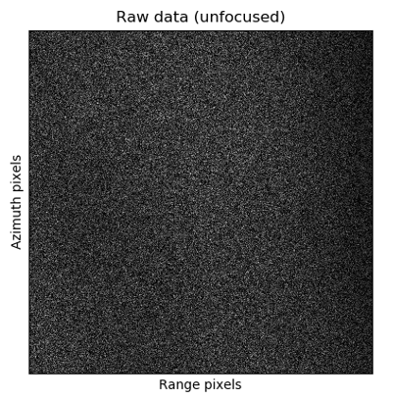
Each pixel is a complex value (which consists of the amplitude and the phase of the signal)
In the RAW data, the signal energy from a point target is spread in range and azimuth

Slide 21
The processing steps
In the RAW data, the signal energy from a point target is spread in range and azimuth, and the purpose of SAR focusing is to collect this dispersed energy into a single pixel in the output image (Single Look Complex, or SLC image).
This sequence of processing steps leads to an actual, visually interpretable image with a much higher resolution that could ever be achieved by a Real Aperture Radar (RAR).

Slide 22
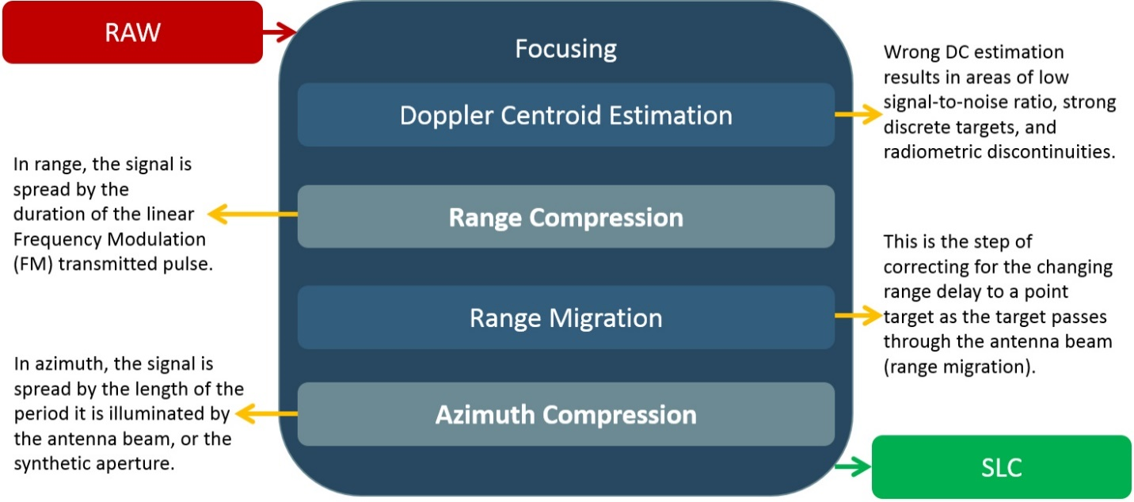

Slide 23
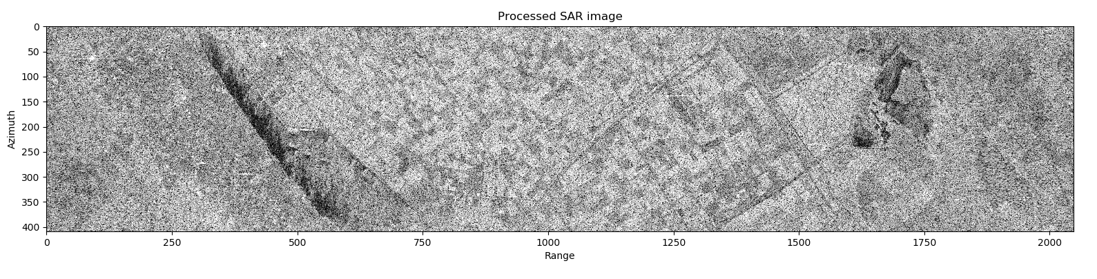

Slide 24
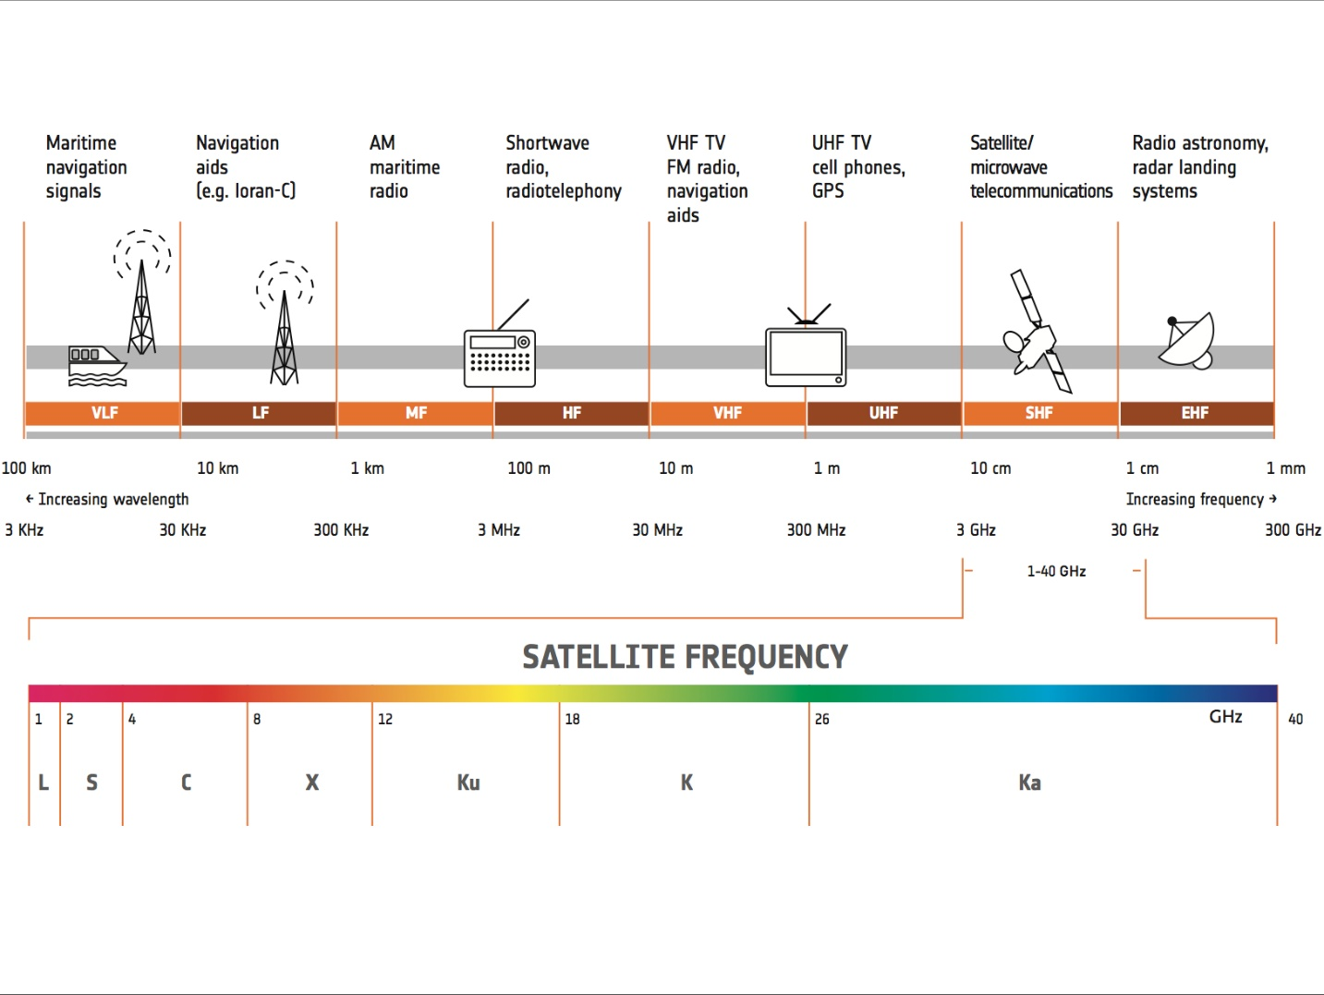
What is a Radar Band?
Microwave frequencies are labelled in Bands. Perhaps you stumbled on this seemingly confusing nomenclature of X-Band, C-Band or L-Band when dealing with radar images.

Slide 25
Popular Radar Bands
Ka-Band
(26 – 40 GHz | 7.5 – 11.54 mm)
Communications satellites, uplink in either the 27.5 GHz and 31 GHz bands, and high-resolution, close-range targeting radars on military aircraft.
S-Band
(2 – 4 GHz | 7.5 – 15 cm)
Weather radar, surface ship radar, and some communications satellites, especially those of NASA for communication with ISS and Space Shuttle.
In May 2009, Inmarsat and Solaris mobile (a joint venture between Eutelsat and Astra) were awarded each a 2×15 MHz portion of the S-band by the European Commission.

Slide 26
Ku-Band
(12 – 18 GHz | 1.67 – 2.5 cm)
Used for satellite communications. In Europe, Ku-band downlink is used from 10.7 GHz to 12.75 GHz for direct broadcast satellite services, such as Astra.
L-Band
(0.5 – 1.5 GHz | 20 – 60 cm)
Global Positioning System (GPS) carriers and also satellite mobile phones, such as Iridium; Inmarsat providing communications at sea, land and air; World Space satellite radio.
X-Band
(8 – 12 GHz | 2.5 – 3.75 cm)
Used in radar applications including continuous-wave, pulsed, single-polarisation, dual- polarisation, synthetic aperture radar and phased arrays.

Slide 27
X-band radar frequency sub-bands are used in civil, military and government institutions for weather monitoring, air traffic control, maritime vessel traffic control, defence tracking and vehicle speed detection for law enforcement.
P-Band (0.25 – 0.5 GHz | 60 – 120 cm)
Future Satellite missions will also utilize the long P-Band frequency band with wavelengths up to 1.2 meters.
C-Band (4 – 8 GHz | 3.75 – 7.5 cm)
Commonly used in areas that are subject to tropical rainfall, since it is less susceptible to rainfade than Ku band (the original Telstar satellite had a transponder operating in this band, used to relay the first live transatlantic TV signal in 1962).

Slide 28
Radar satellites in Space
Radar satellite remote sensing has a long and prosperous tradition on an international scale.
Starting with SeaSat in the late 1970’s, numerous missions contributed to a vast range of data, improving environmental and Earth system sciences.
Since the 1990‘s and 2000’s, very successful satellite missions were launched, for example ERS 1 and 2, ENVISAT and ALOS provided large amounts of data to scientists, commercial users and public authorities.
The establishment of spaceborne sensors with different frequency bands also increased the potential of radar remote sensing to contribute to many scientific endeavors.

Slide 29
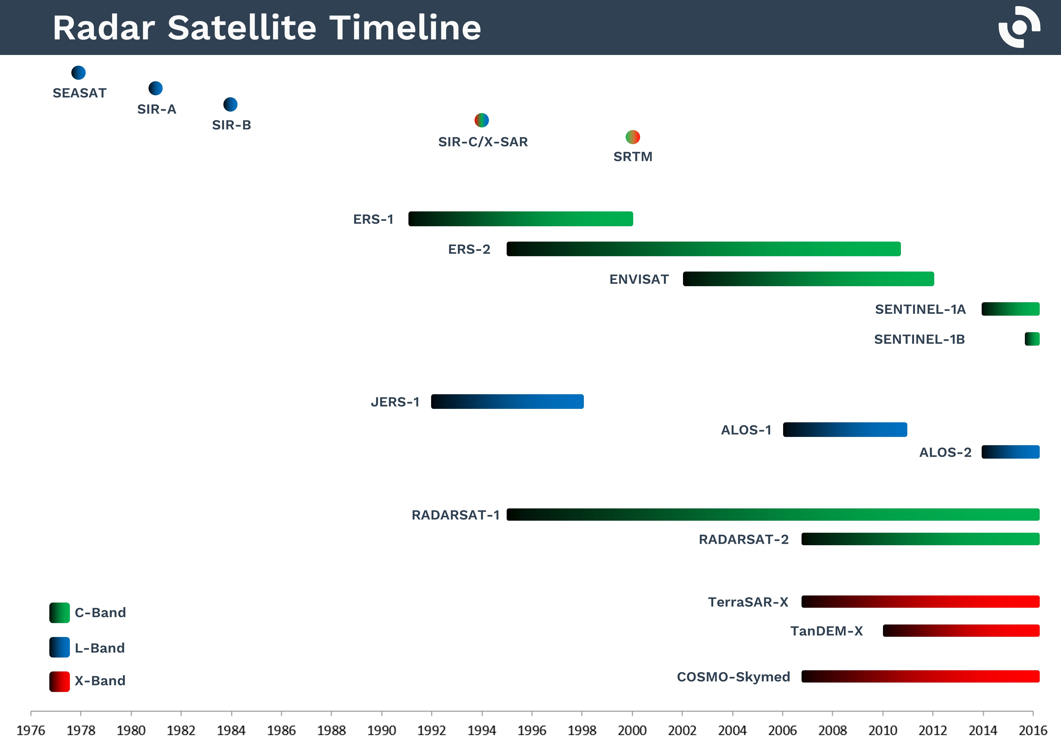

Slide 30
THANK YOU

